Slide 1

“Probability”

Slide 2
Topic: Probabilities of Single Events
EQ: How do you calculate the probability of single events?

Slide 3

Definitions
Probability is the mathematics of chance.
The greater the probability the more
likely the event will occur.
It can be written as a fraction, decimal, percent, or ratio.

Slide 4
Definitions
1
Certain
Probability is the numerical measure of the likelihood that the event will occur.
Value is between 0 and 1.
.5
50/50
Sum of the probabilities of all events
is 1.
0
Impossible

Slide 5
Definitions
The set of all possible outcomes of a probability experiment is the sample space, denoted as S.
e.g. All 6 faces of a die: S = { 1 , 2 , 3 , 4 , 5 , 6 }

Slide 6

Definitions
Other Examples of Sample Spaces may include:
Lists
Tables
Grids
Venn Diagrams
Tree Diagrams
May use a combination of these
Where appropriate always display your sample space

Slide 7
Definitions
An event consists of one or more outcomes and is a subset of the sample space.
Events are often represented by uppercase letters, such as A, B, or C.
Notation: The probability that event E will occur is written P(E) and is read
“the probability of event E.”

Slide 8
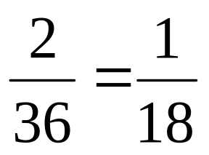
Definitions
The Probability of an Event, E:
Consider a pair of Dice
Each of the Outcomes in the Sample Space are random
and equally likely to occur.
Number of Possible Outcomes
P(E) =
Total Number of Outcomes in S
e.g. P( ) =
(There are 2 ways to get one 6 and the other 4)

Slide 9
Definitions
There are two types of probability
1. Theoretical Probability
Theoretical probability is used when each outcome in a sample space is equally likely to occur.
Number of Event Outcomes
P(E) =
Total Number of Possible Outcomes in S
The Ultimate probability formula ☺

Slide 10
Definitions
2. Experimental Probability
Experimental probability is based upon observations obtained from probability experiments.
Number of Event Occurrences
P(E) =
Total Number of Observations
The experimental probability of an event
E is the relative frequency of event E

Slide 11
Definitions
Law of Large Numbers.
As an experiment is repeated over and over, the experimental probability of an event approaches
the theoretical probability of the event.
The greater the number of trials the more likely the experimental probability of an event will equal its theoretical probability.

Slide 12
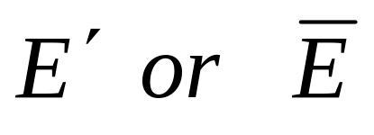
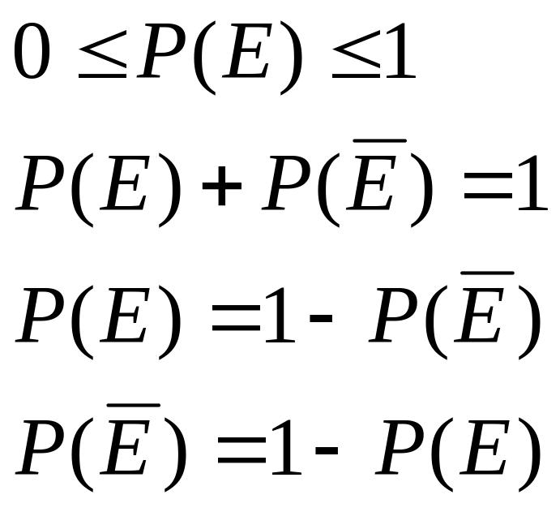
Complimentary Events
The complement of event E is the set of all outcomes in a sample space that are not included in event E.
The complement of event E is denoted by
Properties of Probability:

Slide 13
Topic: Probabilities of Combined Events
EQ: How do you calculate the probability of combined events?

Slide 14
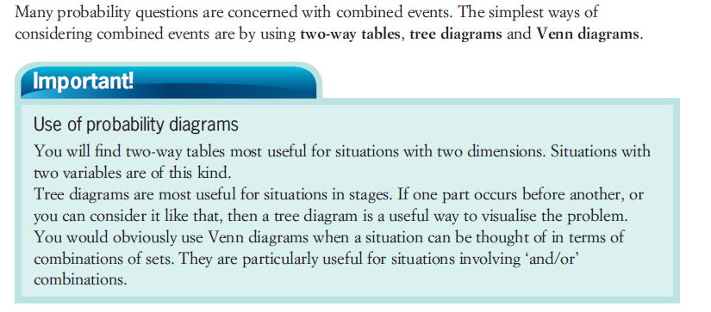

Slide 15
Tree Diagrams
A way of showing the possibilities of two or more events
Simple diagram we use to calculate the probabilities of two or more events

Slide 16
A fair coin is flipped twice
INDEPENDENT EVENTS
Outcomes
1st
2nd
H
HH
H
T
HT
Possible Outcomes
H
TH
T
T
TT
Definition:
Two events A and B are independent if the occurrence of one event has no effect on the chance that the other event will happen.

Slide 17
For example – 10 coloured beads in a bag – 3 Red, 2 Blue, 5 Green. One taken, colour noted, returned to bag, then a second taken.
1st
2nd
Outcomes
R
RR
B
RB
R
G
RG
R
BR
INDEPENDENT EVENTS
B
B
BB
G
BG
R
GR
G
B
GB
G
GG

Slide 18
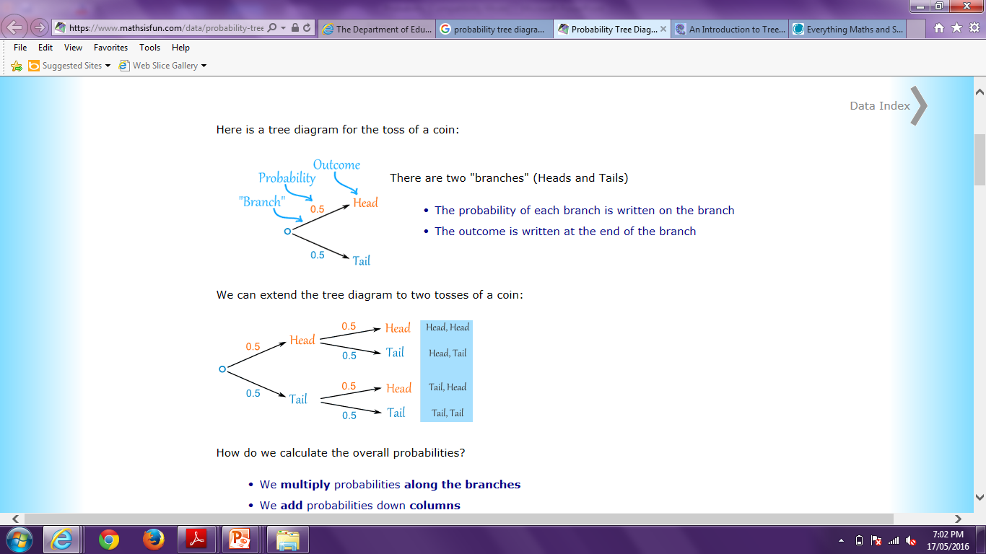
Probability Tree Diagrams

Slide 19
Probability Tree Diagrams

Slide 20
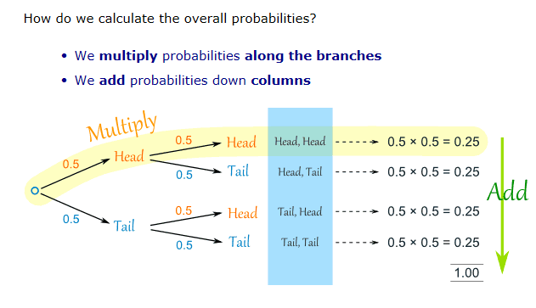
Probability Tree Diagrams

Slide 21
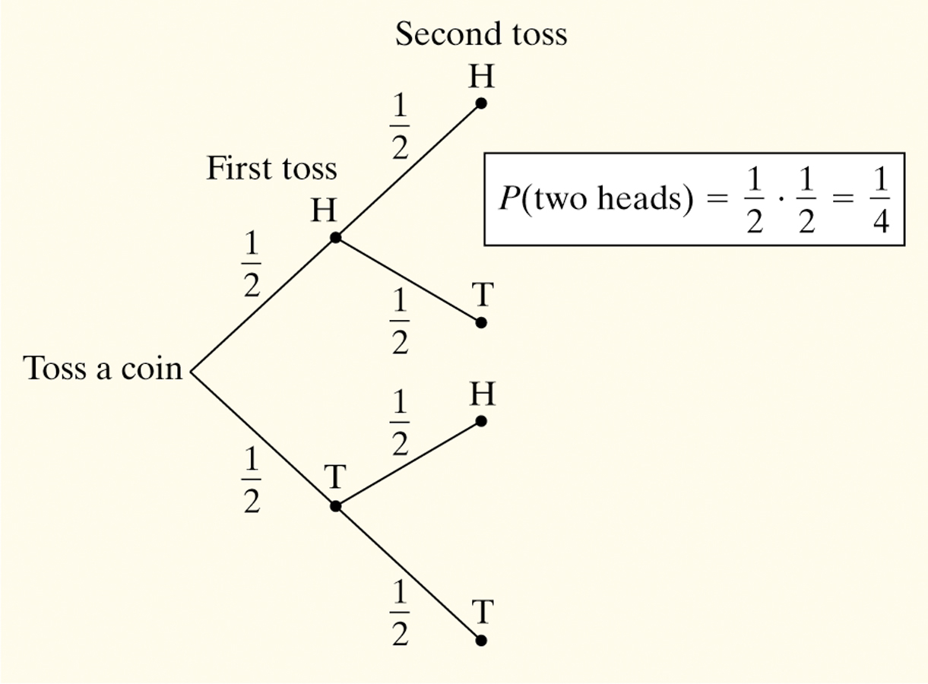
Probability Tree Diagrams
Consider flipping a coin twice.
What is the probability of getting two heads?
Sample Space:
HH HT TH TT
So, P(two heads) = P(HH) = 1/4

Slide 22
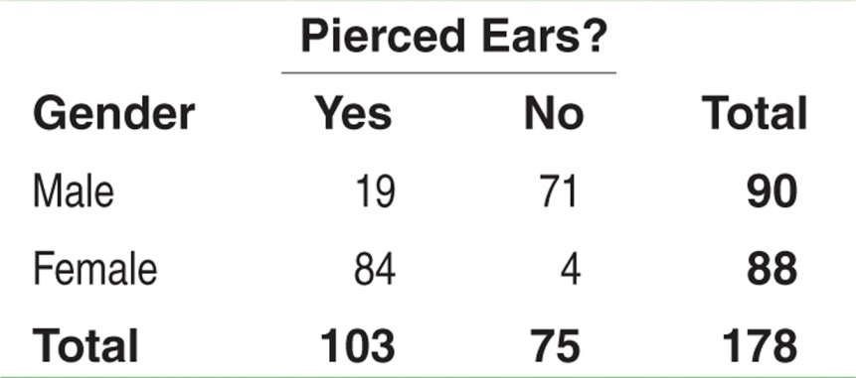
Probability Rules
Two-Way Tables and Probability
When finding probabilities involving two events, a two-way table can display the sample space in a way that makes probability calculations easier.
Consider the following table. Suppose we choose a student at random. Find the probability that the student
has pierced ears.
is a male with pierced ears.
is a male or has pierced ears.
Define events A: is male and B: has pierced ears.
(a) Each student is equally likely to be chosen. 103 students have pierced ears. So, P(pierced ears) = P(B) = 103/178.
(b) We want to find P(male and pierced ears), that is, P(A and B). Look at the intersection of the “Male” row and “Yes” column. There are 19 males with pierced ears. So, P(A and B) = 19/178.
(c) We want to find P(male or pierced ears), that is, P(A or B). There are 90 males in the class and 103 individuals with pierced ears. However, 19 males have pierced ears – don’t count them twice!
P(A or B) = (19 + 71 + 84)/178. So, P(A or B) = 174/178

Slide 23

The Multiplication Rule
If events A and B are independent, then the probability of two events, A and B occurring in a sequence (or simultaneously) is:
This rule can extend to any number of independent events.
Two events are independent if the occurrence of the first event does not affect the probability of the
occurrence of the second event. More on this later

Slide 24
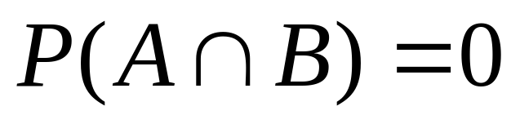
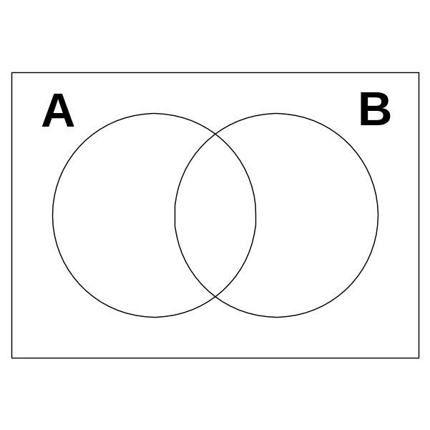
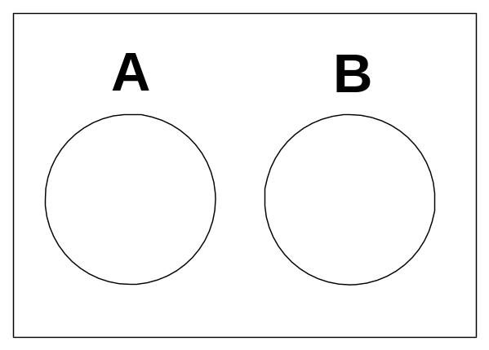
Mutually Exclusive
Two events A and B are mutually exclusive if and only if:
In a Venn diagram this means that event A is disjoint from event B.
A and B are M.E.
A and B are not M.E.

Slide 25
The Addition Rule
The probability that at least one of the events A or B will occur, P(A or B), is given by:
If events A and B are mutually exclusive, then the addition rule is simplified to:
This simplified rule can be extended to any number of mutually exclusive events.

Slide 26
Conditional Probability
Conditional probability is the probability of an event occurring, given that another event has already
occurred.
Conditional probability restricts the sample space.
The conditional probability of event B occurring, given that event A has occurred, is denoted by P(B|A) and is read as “probability of B, given A.”
We use conditional probability when two events occurring in sequence are not independent. In other words, the fact that the first event (event A) has occurred affects the probability that the second event (event B) will occur.

Slide 27
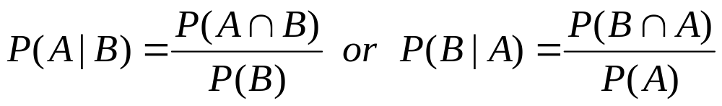
Conditional Probability
Formula for Conditional Probability
Better off to use your brain and work out conditional probabilities from looking at the sample space, otherwise use the formula.

Slide 28
Conditional Probability
e.g. There are 2 red and 3 blue counters in a bag and, without looking, we take out one counter and do not replace it.
The probability of a 2nd counter taken from the bag being red depends on whether the 1st was red or blue.
Conditional probability problems can be solved by considering the individual possibilities or by using a table, a Venn diagram, a tree diagram or a formula.
Harder problems are best solved by using a formula together with a tree diagram.

Slide 29
e.g. 1. The following table gives data on the type of car, grouped by petrol consumption, owned by 100 people.
Low
Medium
High
Total
Male
12
33
7
Female
23
21
4
One person is selected at random.
100
L is the event “the person owns a low rated car”

Slide 30
e.g. 1. The following table gives data on the type of car, grouped by petrol consumption, owned by 100 people.
Low
Medium
High
Total
Male
12
33
7
Female
23
21
4
One person is selected at random.
100
L is the event “the person owns a low rated car”
F is the event “a female is chosen”.

Slide 31
e.g. 1. The following table gives data on the type of car, grouped by petrol consumption, owned by 100 people.
Low
Medium
High
Total
Male
12
33
7
Female
23
21
4
One person is selected at random.
100
L is the event “the person owns a low rated car”
F is the event “a female is chosen”.

Slide 32
e.g. 1. The following table gives data on the type of car, grouped by petrol consumption, owned by 100 people.
Low
Medium
High
Total
Male
12
33
7
Female
23
21
4
One person is selected at random.
100
L is the event “the person owns a low rated car”
F is the event “a female is chosen”.
Find (i) P(L) (ii) P(F ∩ L) (iii) P(F L)
There is no need for a Venn diagram or a formula to solve this type of problem.
We just need to be careful which row or column we look at.

Slide 33


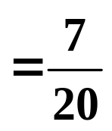


Low
Solution:
Low
Medium
High
Total
Male
12
12
33
7
Female
23
23
21
4
35
100
100
Find (i) P(L) (ii) P(F ∩ L) (iii) P(F L)
(Best to leave the answers as fractions)
(i) P(L) =

Slide 34
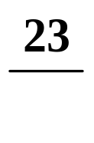

Solution:
Low
Medium
High
Total
Male
12
33
7
Female
23
23
21
4
100
100
Find (i) P(L) (ii) P(F ∩ L) (iii) P(F L)
(i) P(L) =
(ii) P(F ∩ L) =
The probability of selecting a female with a low rated car.

Slide 35

Solution:
Low
Medium
High
Total
Male
12
12
33
7
Female
23
23
21
4
35
100
Find (i) P(L) (ii) P(F ∩ L) (iii) P(F L)
(i) P(L) =
The sample space is restricted from 100 to 35.
(ii) P(F ∩ L) =
We must be careful with the denominators in (ii) and (iii). Here we are given the car is low rated. We want the total of that column.
(iii) P(F L) =
The probability of selecting a female given the car is low rated.

Slide 36

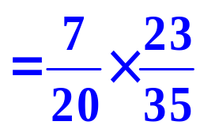
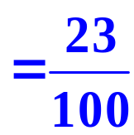

Solution:
Low
Medium
High
Total
Male
12
33
7
Female
23
21
4
100
Find (i) P(L) (ii) P(F ∩ L) (iii) P(F L)
(i) P(L) =
Notice that
(ii) P(F ∩ L) =
P(L) × P(F L)
(iii) P(F L) =
= P(F ∩ L)
So, P(F ∩ L) = P(F|L) × P(L)

Slide 37
e.g. 2. I have 2 packets of seeds. One contains 20 seeds and although they look the same, 8 will give red flowers and 12 blue. The 2nd packet has 25 seeds of which 15 will be red and 10 blue.
Draw a Venn diagram and use it to illustrate the conditional probability formula.
Solution:
Let R be the event “ Red flower ” and
F be the event “ First packet ”
F
R
Red in the 1st packet

Slide 38
e.g. 2. I have 2 packets of seeds. One contains 20 seeds and although they look the same, 8 will give red flowers and 12 blue. The 2nd packet has 25 seeds of which 15 will be red and 10 blue.
Draw a Venn diagram and use it to illustrate the conditional probability formula.
Solution:
Let R be the event “ Red flower ” and
F be the event “ First packet ”
F
R
8
Red in the 1st packet

Slide 39
e.g. 2. I have 2 packets of seeds. One contains 20 seeds and although they look the same, 8 will give red flowers and 12 blue. The 2nd packet has 25 seeds of which 15 will be red and 10 blue.
Draw a Venn diagram and use it to illustrate the conditional probability formula.
Solution:
Let R be the event “ Red flower ” and
F be the event “ First packet ”
F
R
8
Blue in the 1st packet

Slide 40
e.g. 2. I have 2 packets of seeds. One contains 20 seeds and although they look the same, 8 will give red flowers and 12 blue. The 2nd packet has 25 seeds of which 15 will be red and 10 blue.
Draw a Venn diagram and use it to illustrate the conditional probability formula.
Solution:
Let R be the event “ Red flower ” and
F be the event “ First packet ”
F
R
12
8
Blue in the 1st packet

Slide 41
e.g. 2. I have 2 packets of seeds. One contains 20 seeds and although they look the same, 8 will give red flowers and 12 blue. The 2nd packet has 25 seeds of which 15 will be red and 10 blue.
Draw a Venn diagram and use it to illustrate the conditional probability formula.
Solution:
Let R be the event “ Red flower ” and
F be the event “ First packet ”
F
R
12
8
Red in the 2nd packet

Slide 42
e.g. 2. I have 2 packets of seeds. One contains 20 seeds and although they look the same, 8 will give red flowers and 12 blue. The 2nd packet has 25 seeds of which 15 will be red and 10 blue.
Draw a Venn diagram and use it to illustrate the conditional probability formula.
Solution:
Let R be the event “ Red flower ” and
F be the event “ First packet ”
F
R
12
8
15
Red in the 2nd packet

Slide 43
e.g. 2. I have 2 packets of seeds. One contains 20 seeds and although they look the same, 8 will give red flowers and 12 blue. The 2nd packet has 25 seeds of which 15 will be red and 10 blue.
Draw a Venn diagram and use it to illustrate the conditional probability formula.
Solution:
Let R be the event “ Red flower ” and
F be the event “ First packet ”
F
R
12
8
15
Blue in the 2nd packet

Slide 44
e.g. 2. I have 2 packets of seeds. One contains 20 seeds and although they look the same, 8 will give red flowers and 12 blue. The 2nd packet has 25 seeds of which 15 will be red and 10 blue.
Draw a Venn diagram and use it to illustrate the conditional probability formula.
Solution:
Let R be the event “ Red flower ” and
F be the event “ First packet ”
F
R
12
8
15
10
Blue in the 2nd packet

Slide 45
e.g. 2. I have 2 packets of seeds. One contains 20 seeds and although they look the same, 8 will give red flowers and 12 blue. The 2nd packet has 25 seeds of which 15 will be red and 10 blue.
Draw a Venn diagram and use it to illustrate the conditional probability formula.
Solution:
Let R be the event “ Red flower ” and
F be the event “ First packet ”
F
R
12
8
15
Total: 20 + 25
10

Slide 46
e.g. 2. I have 2 packets of seeds. One contains 20 seeds and although they look the same, 8 will give red flowers and 12 blue. The 2nd packet has 25 seeds of which 15 will be red and 10 blue.
Draw a Venn diagram and use it to illustrate the conditional probability formula.
Solution:
Let R be the event “ Red flower ” and
F be the event “ First packet ”
45
F
R
12
8
15
Total: 20 + 25
10

Slide 47
e.g. 2. I have 2 packets of seeds. One contains 20 seeds and although they look the same, 8 will give red flowers and 12 blue. The 2nd packet has 25 seeds of which 15 will be red and 10 blue.
Draw a Venn diagram and use it to illustrate the conditional probability formula.
Solution:
Let R be the event “ Red flower ” and
F be the event “ First packet ”
45
F
R
12
8
15
10

Slide 48
e.g. 2. I have 2 packets of seeds. One contains 20 seeds and although they look the same, 8 will give red flowers and 12 blue. The 2nd packet has 25 seeds of which 15 will be red and 10 blue.
Draw a Venn diagram and use it to illustrate the conditional probability formula.
Solution:
Let R be the event “ Red flower ” and
F be the event “ First packet ”
45
P(R ∩ F) =
R
F
12
8
15
10

Slide 49

e.g. 2. I have 2 packets of seeds. One contains 20 seeds and although they look the same, 8 will give red flowers and 12 blue. The 2nd packet has 25 seeds of which 15 will be red and 10 blue.
Draw a Venn diagram and use it to illustrate the conditional probability formula.
Solution:
Let R be the event “ Red flower ” and
F be the event “ First packet ”
45
P(R ∩ F) =
R
F
12
8
15
10

Slide 50

e.g. 2. I have 2 packets of seeds. One contains 20 seeds and although they look the same, 8 will give red flowers and 12 blue. The 2nd packet has 25 seeds of which 15 will be red and 10 blue.
Draw a Venn diagram and use it to illustrate the conditional probability formula.
Solution:
Let R be the event “ Red flower ” and
F be the event “ First packet ”
45
P(R ∩ F) =
R
F
12
8
15
10

Slide 51

e.g. 2. I have 2 packets of seeds. One contains 20 seeds and although they look the same, 8 will give red flowers and 12 blue. The 2nd packet has 25 seeds of which 15 will be red and 10 blue.
Draw a Venn diagram and use it to illustrate the conditional probability formula.
Solution:
Let R be the event “ Red flower ” and
F be the event “ First packet ”
45
P(R ∩ F) =
R
F
P(R F) =
12
8
15
10

Slide 52

e.g. 2. I have 2 packets of seeds. One contains 20 seeds and although they look the same, 8 will give red flowers and 12 blue. The 2nd packet has 25 seeds of which 15 will be red and 10 blue.
Draw a Venn diagram and use it to illustrate the conditional probability formula.
Solution:
Let R be the event “ Red flower ” and
F be the event “ First packet ”
45
P(R ∩ F) =
R
F
P(R F) =
P(F) =
12
8
15
10

Slide 53

e.g. 2. I have 2 packets of seeds. One contains 20 seeds and although they look the same, 8 will give red flowers and 12 blue. The 2nd packet has 25 seeds of which 15 will be red and 10 blue.
Draw a Venn diagram and use it to illustrate the conditional probability formula.
Solution:
Let R be the event “ Red flower ” and
F be the event “ First packet ”
45
P(R ∩ F) =
R
F
P(R F) =
P(F) =
12
8
15
10

Slide 54
e.g. 2. I have 2 packets of seeds. One contains 20 seeds and although they look the same, 8 will give red flowers and 12 blue. The 2nd packet has 25 seeds of which 15 will be red and 10 blue.
Draw a Venn diagram and use it to illustrate the conditional probability formula.
Solution:
Let R be the event “ Red flower ” and
F be the event “ First packet ”
45
P(R ∩ F) =
R
F
P(R F) =
P(F) =
12
8
15
10

Slide 55
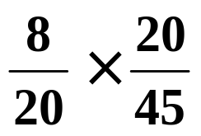
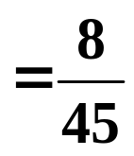


e.g. 2. I have 2 packets of seeds. One contains 20 seeds and although they look the same, 8 will give red flowers and 12 blue. The 2nd packet has 25 seeds of which 15 will be red and 10 blue.
Draw a Venn diagram and use it to illustrate the conditional probability formula.
Solution:
Let R be the event “ Red flower ” and
F be the event “ First packet ”
45
P(R ∩ F) =
R
F
P(R F) =
P(F) =
12
8
15
10
P(R F) × P(F) =
So,
P(R ∩ F) = P(R|F) × P(F)

Slide 56
Probability Tree Diagrams
The probability of a complex event can be found using a probability tree diagram.
1. Draw the appropriate tree diagram.
2. Assign probabilities to each branch.
(Each section sums to 1.)
3. Multiply the probabilities along individual branches to find the probability of the outcome at the end of each branch.
4. Add the probabilities of the relevant outcomes, depending on the event.

Slide 57



e.g. 3. In November, the probability of a man getting to work on time if there is fog on the M6 is .
If the visibility is good, the probability is .
The probability of fog at the time he travels is .
(a) Calculate the probability of him arriving on time.
(b) Calculate the probability that there was fog given that he arrives on time.
There are lots of clues in the question to tell us we are dealing with conditional probability.

Slide 58
e.g. 3. In November, the probability of a man getting to work on time if there is fog on the M6 is .
If the visibility is good, the probability is .
The probability of fog at the time he travels is .
(a) Calculate the probability of him arriving on time.
(b) Calculate the probability that there was fog given that he arrives on time.
There are lots of clues in the question to tell us we are dealing with conditional probability.
Solution:
Let T be the event “ getting to work on time ”
Let F be the event “ fog on the M6 ”
Can you write down the notation for the probabilities that we want to find in (a) and (b)?

Slide 59
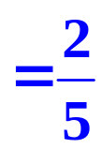
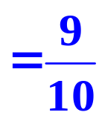
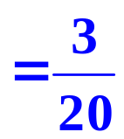
P(T)
(a) Calculate the probability of him arriving on time.
(b) Calculate the probability that there was fog given that he arrives on time.
P(F T)
Can you also write down the notation for the three probabilities given in the question?
“ the probability of a man getting to work on time if there is fog is ”
P(T F)
Not foggy
P(T F/)
“ If the visibility is good, the probability is ”.
“ The probability of fog at the time he travels is ”.
P(F)
This is a much harder problem so we draw a tree diagram.

Slide 60

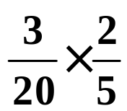
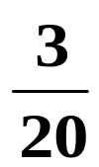
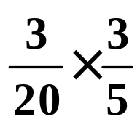


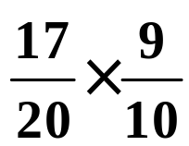
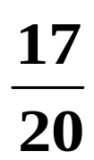

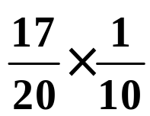
P(T F)
P(T F/)
P(F)
On time
T
F
Fog
Not on time
T/
On time
T
No Fog
F/
Not on time
T/
Each section sums to 1

Slide 61
P(T F)
P(T F/)
P(F)
T
F
T/
T
F/
T/
Because we only reach the 2nd set of branches after the 1st set has occurred, the 2nd set must represent conditional probabilities.

Slide 62
(a) Calculate the probability of him arriving on time.
T
F
T/
T
F/
T/

Slide 63
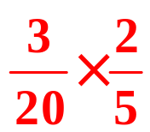
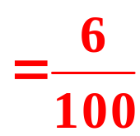
(a) Calculate the probability of him arriving on time.
T
F
( foggy and he arrives on time )
T/
T
F/
T/

Slide 64
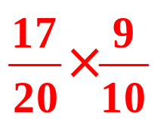
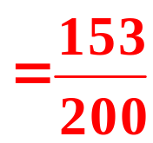
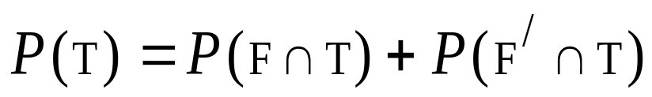
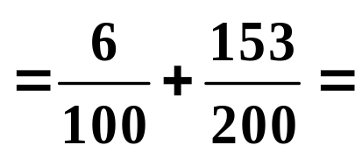
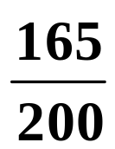

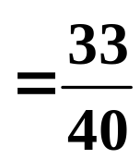

(a) Calculate the probability of him arriving on time.
T
F
T/
T
F/
( not foggy and he arrives on time )
T/

Slide 65
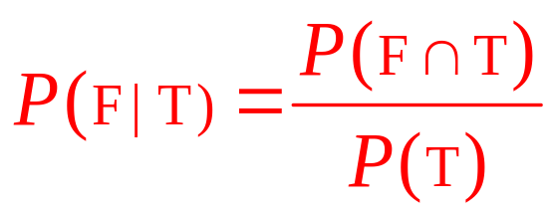


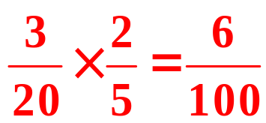


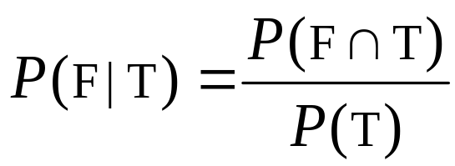
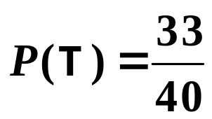
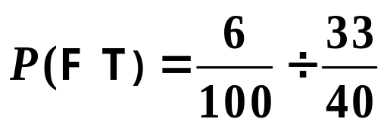

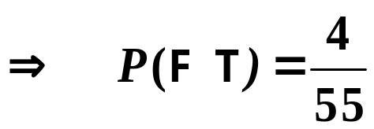
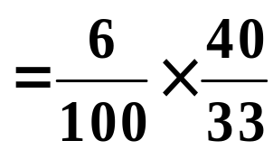



(b) Calculate the probability that there was fog given that he arrives on time.
We need
Fog on M 6
Getting to work
T
F
From part (a),

Slide 66



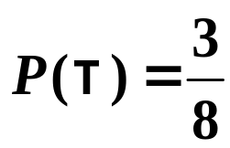
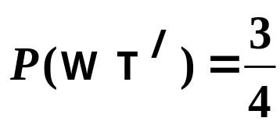
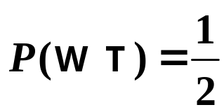
Eg 4. The probability of a maximum temperature of 28° or more on the 1st day of Wimbledon ( tennis competition! )
has been estimated as . The probability of a particular Aussie player winning on the 1st day if it is below 28° is estimated to be but otherwise only .
Draw a tree diagram and use it to help solve the following:
(i) the probability of the player winning,
(ii) the probability that, if the player has won, it was at least 28°.
Solution:
Let T be the event “ temperature 28° or more ”
Let W be the event “ player wins ”
Then,

Slide 67

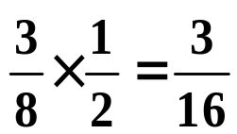


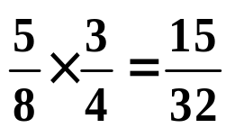

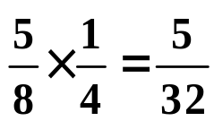

Let T be the event “ temperature 28° or more ”
Let W be the event “ player wins ”
Then,
Wins
W
High temp
T
Loses
W/
Sum = 1
W
Wins
Lower temp
T/
W/
Loses

Slide 68
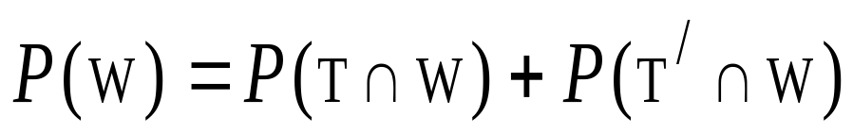
W
T
W/
W
T/
W/
(i)

Slide 69
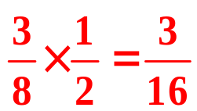



W
T
W/
W
T/
W/
(i)

Slide 70


W
T
W/
W
T/
W/
(ii)

Slide 71


W
T
W/
W
T/
W/
(ii)

Slide 72






W
T
W/
W
T/
W/
(ii)

Slide 73
Independent Events
We can deduce an important result from the conditional law of probability:
If B has no effect on A, then, P(A B) = P(A) and we say the events are independent.
( The probability of A does not depend on B. )
P(A|B) =
P(A ∩ B)
So,
P(B)
P(A ∩ B)
becomes P(A) =
P(B)
or P(A ∩ B) = P(A) × P(B)

Slide 74
Independent Events
Tests for independence
P(A B) = P(A)
P(B A) = P(B)
or
P(A ∩ B) = P(A) × P(B)

Slide 75



Expected Value
Suppose that the outcomes of an experiment are real numbers called
and suppose that these outcomes have probabilities
respectively. Then the expected
value of x, E(x), of the experiment
is:

Slide 76



Expected Value
Example
At a raffle, 1500 tickets are sold at $2 each for four prizes of $500, $250, $150, and $75. What is the expected value of your gain if you play?
Gain
$498
$248
$148
$73
-$2
P(x)

Slide 77

Odds
When one speaks about the odds in favour of an event, they are actually stating the number of favourable outcomes of an event to the number
of unfavourable outcomes of the event, assuming that the outcomes are equally likely.
The odds in favour of event E are:
n(E):n(E) P(E):P(E)
The odds against event E are
n(E):n(E) P(E):P(E)
If the odds in favour of E are a:b, then

Slide 78
Applicable Mathematics
“Probability”
www.mathxtc.com

